Slide 1
Machine learning Migraine Classifier
By: Michael McGivern

Slide 2
Problem Statement
To build and deploy a Machine Learning-based migraine classification model that will correctly classify migraines.

Slide 3

Technology stack
Python (Pandas, NumPy, SciPy) for data cleaning, analysis and statistical test
Python’s Collections, Warnings, Sys and Site for utility
Matplotlib, Seaborn and Plotly for Visualizations
Jupyter Notebook for Exploratory Analysis
Sklearn for Machine Learning algorithms
Xgboot and Lightgbm for complex Machine Learning algorithms
Tensorflow Keras for Deep Learning Neural Networks
Imblearn SMOTE for data balancing, synthesis and interpolation
Optuna for model optimization
Joblib and Pickle for Model Storage
PowerPoint for Storytelling and reporting

Slide 4

Features of dataset​
Age
Duration
Frequency
Location
Character
Intensity
Symptoms
Dysfunctional Physical Factor
Type or Migraine

Slide 5
Exploratory data analysis
With Statistical Summary

Slide 6
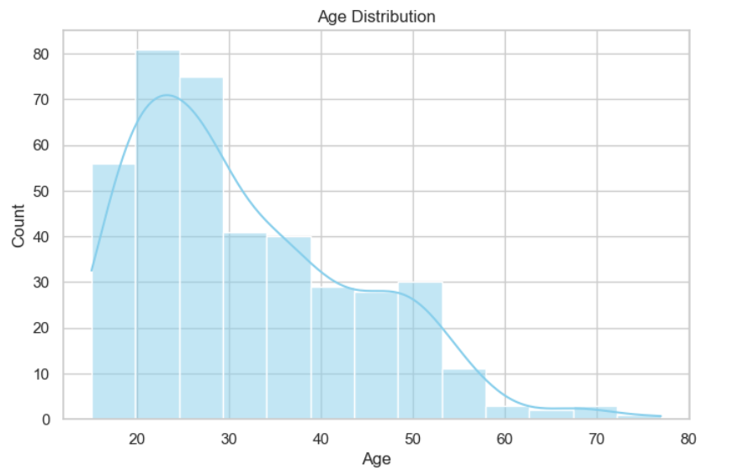
Age Distribution
This chart shows a right-skewed dataset with the majority of the patients within the dataset being of a younger age.
Thus, age bias will be an important limitation of the models trained as older aged individuals are not as represented, the models trained off this dataset could draw misleading conclusions for older aged individuals

Slide 7
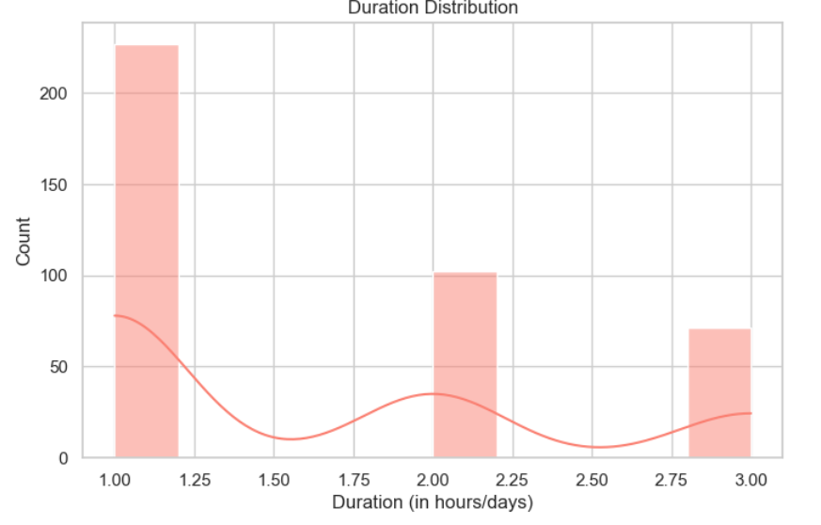
Duration of migraine distribution
This chart shows that the vast majority of patients have a migraine that lasts about one hour.
This chart shows a monotonic decline whereas duration increases frequency drops off sharply.

Slide 8
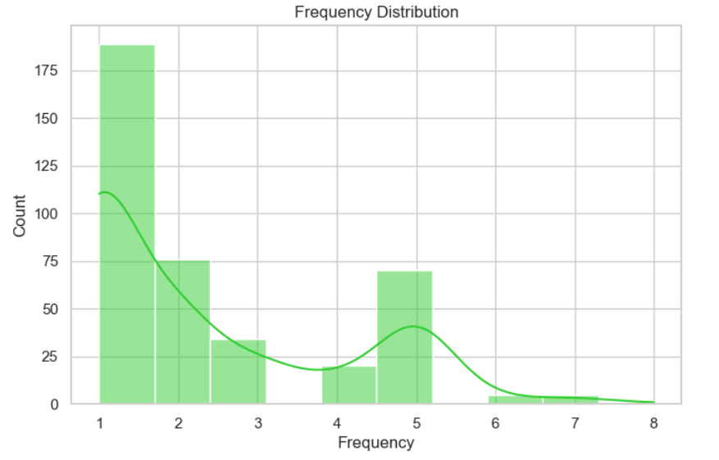
Frequency of migraine distribution
This chart again exhibits a right skewed distribution. This chart along with the last one shows that the overall prevalence of migraines tends to be mild in most cases

Slide 9
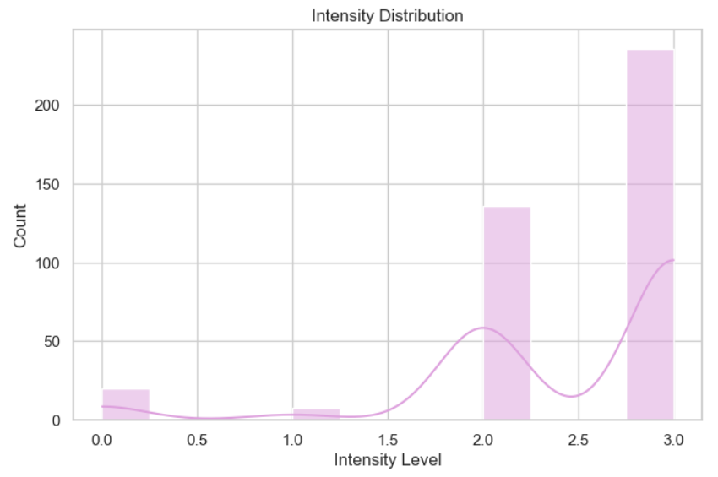
Intensity Distribution
This Intensity Distribution chart shows a left skewed data showing that while the frequency and duration of migraines tend to be low the pain caused by migraines is incredibly high

Slide 10
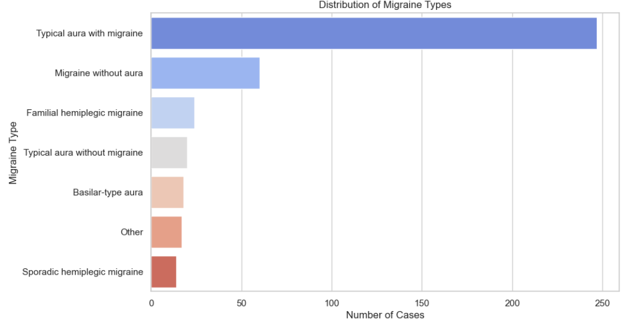
Distribution of migraine types​
This chart show the frequency of each type of migraine diagnosis within the dataset showing that the most common diagnoses are moderately severe.
The Sporadic hemiplegic migraines and the Basilar-type migraines are the most severe followed by typical aura with migraine and migraine without aura. Finally, the least severe type is a typical aura without migraine.

Slide 11
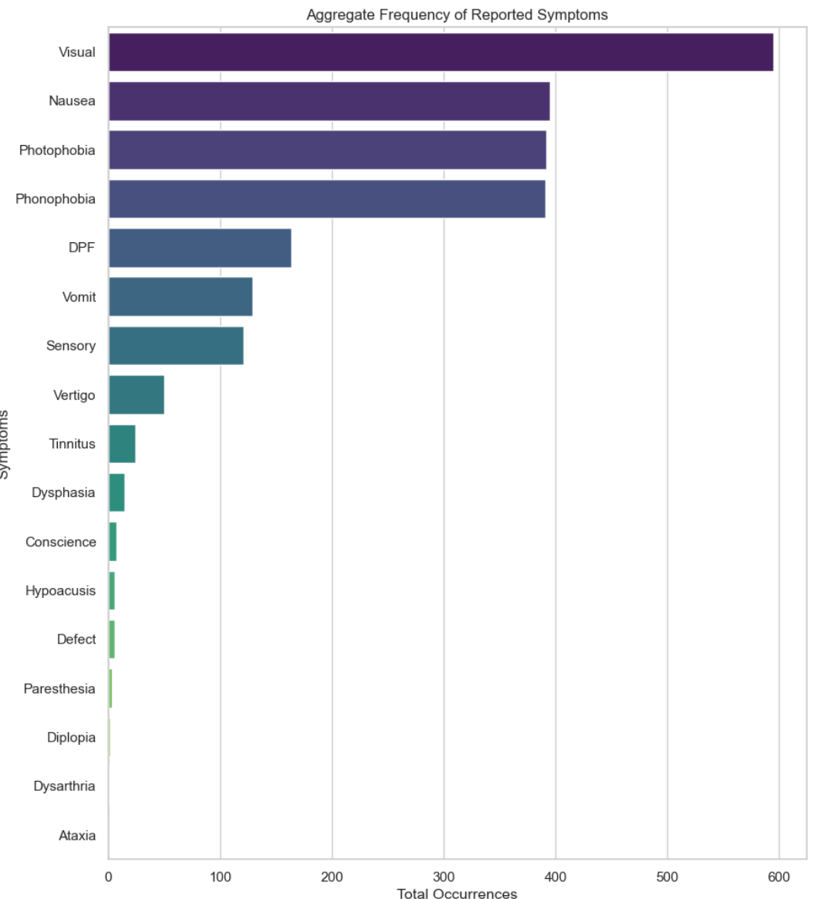
Reported Symptom Frequency
This chart shows which symptoms are common among all migraines. Further breakdown of common symptoms by each migraine type is warranted to start to show correlation between the data and the specific migraine diagnosis

Slide 12
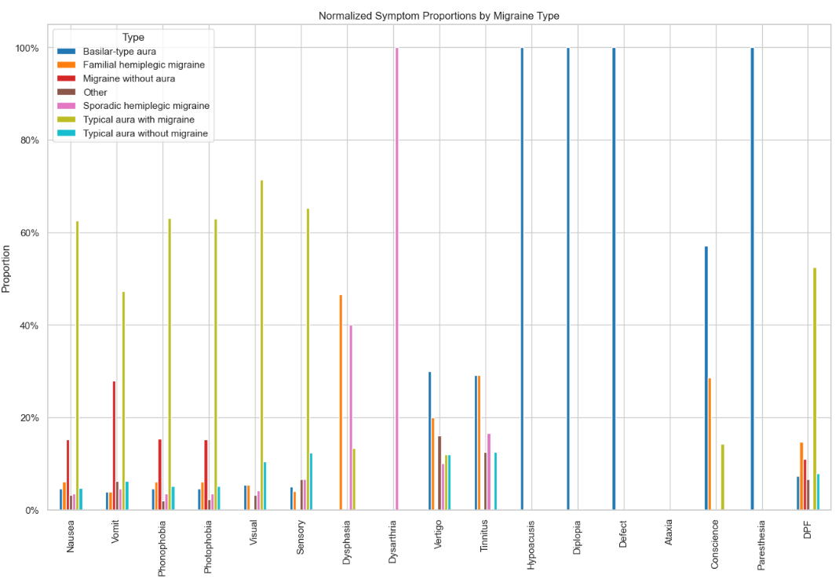
Symptom occurrence by migraine type​
This chart shows a normalized perspective on all symptoms broken down by migraine type. Key insights can be made.
Basilar migraines will have Hypoacusis, Diplopia, Defect and Paresthesia 100% of the time.
Sporadic hemiplegic migraines have Dysarthria 100% of the time.
Typical migraines are most likely to have Nasua, vomiting and visual / sensory impairment.

Slide 13
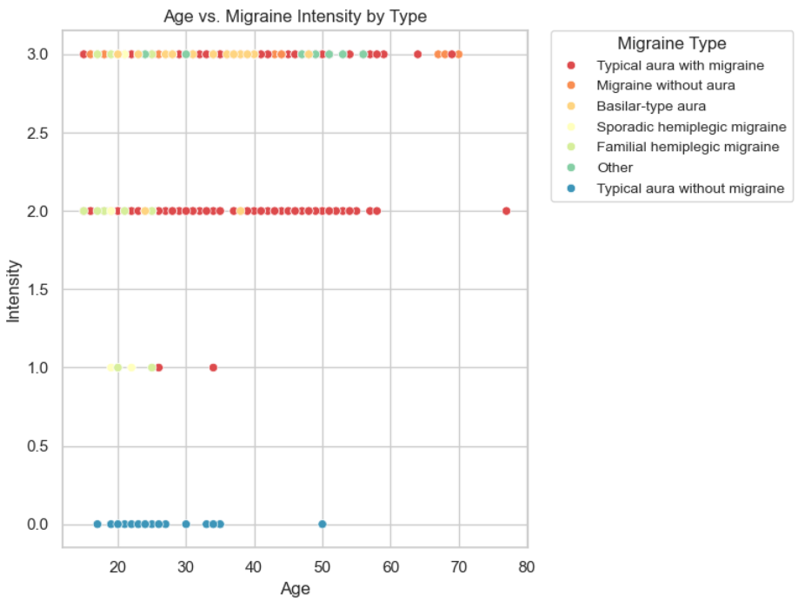
Age vs intensity by migraine type scatter plot​
This scatterplot shows two key insights.
First, the more severe types of migraines will be much more intense.
Second, older patients are much more likely to be diagnosis with a severe form of migraine and thus have a higher pain intensity. For instance, those over 50 will have a severe diagnosis type 100% of the time in this dataset.

Slide 14
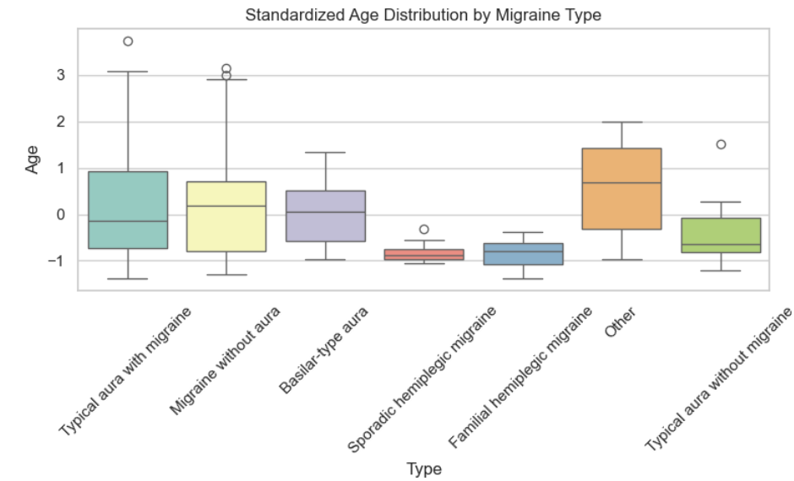
Standardized age By migraine type
This chart shows the distribution of the age of each migraine type.
Quick tip on standardized values:
The closer a value is to 0 the closer it is to the global age average for this dataset. Negative numbers are below the dataset average and positive numbers are above the average. Each number represents one standard deviation.

Slide 15
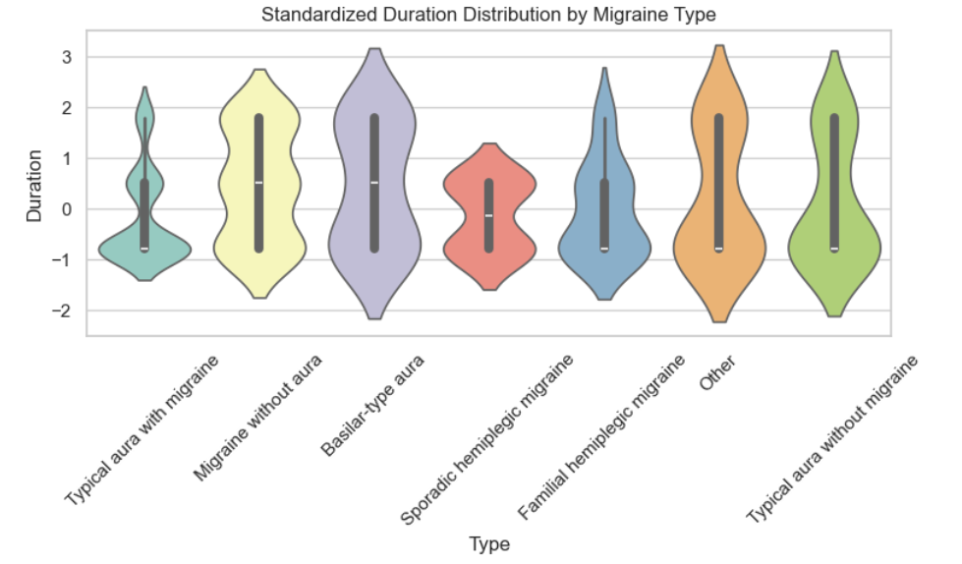
Standardized duration by migraine type
This violin plot shows the distribution of duration across each migraine type.
Basilar-type aura migraines are the longest lasting on average across all types.

Slide 16
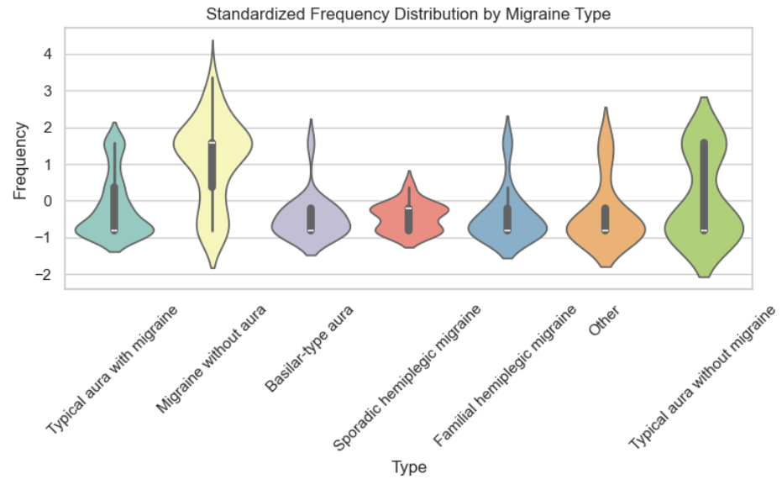
Standardized frequency by migraine type
This violin plot shows the standardized frequency by migraine type across all patients
All types except Migraine without aura have a below average frequency.

Slide 17
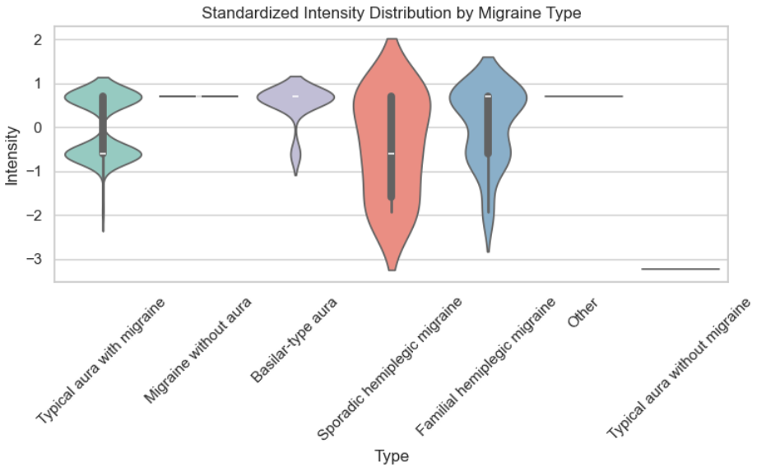
Standardized intensity by migraine type
This violin plot shows the intensity across each migraine type standardized from the average intensity from the entire dataset.
Migraine without aura and Other are the only two with above average reported intensity by paitnets.

Slide 18
Data preprocessing

Slide 19
Label encoding
For all categorical data such as location and character ID numbers are given to each unique value and new columns are created to the Data-Frame so the machine learning algorithms can process them.

Slide 20
Multilabel binarizing symptom data
All symptoms are encoded with 1 or 0 for yes or no if each patient has the symptom. Cells are then updated within the Data-Frame.

Slide 21

Feature Scaling
Age, Duration and Frequency are scaled and standardized by calculating the mean and standard deviation of each of the columns and then centering the values via the Z score equation.
The centered and scaled data is then saved to the Data-Frame.

Slide 22
Synthetic Minority Over-sampling Technique (SMOTE)
Since there is an imbalance between types as seen with the following chart, SMOTE is used to help the minority categories stay relevant in the dataset so the majority type is not dominating the machine learning algorithms.
This is done by analysis the data and creating synthetic examples of underrepresented types that match the original data.

Slide 23
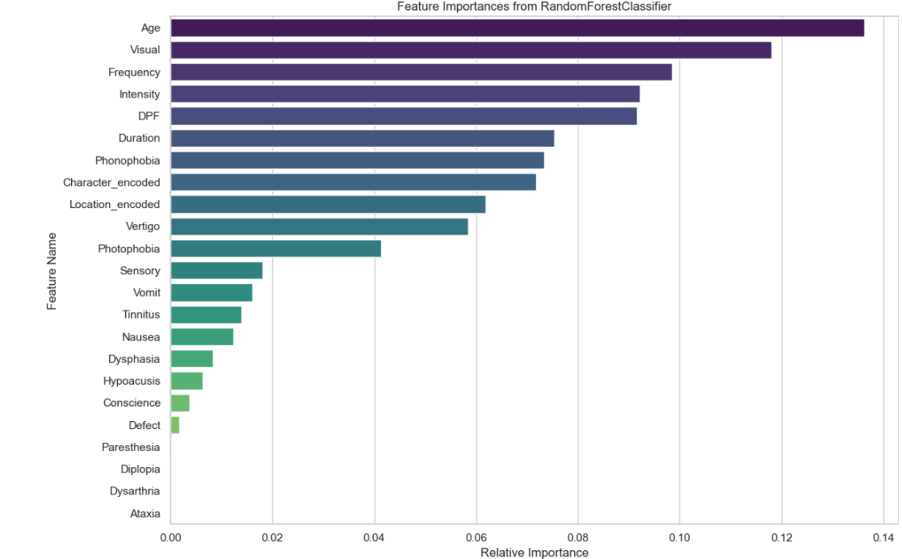
Feature selection and Dimensional Reduction
Initial Machine learning Models are implemented to find which values are most significant for correctly diagnosis each type of migraine.
This is a great indicator if which columns to weight, however this method is very sensitive to highly correlated data meaning the machine learning model cannot distinguish which variable is influencing the outcome which weakens the model’s stability.

Slide 24
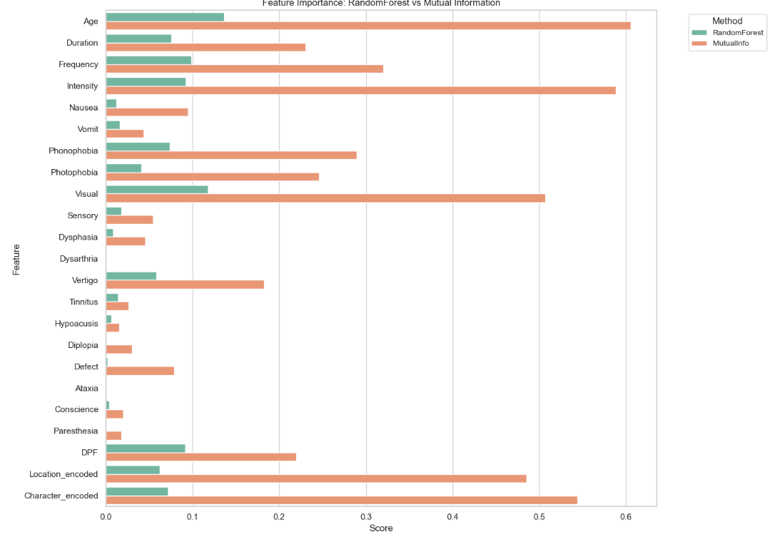
Mutual Information scoring
Using mutual information classification, we can use the generated scores and combine them with the feature selection scores to create the best non bias weighting of the various features.
The scores are combined by simply adding them together

Slide 25
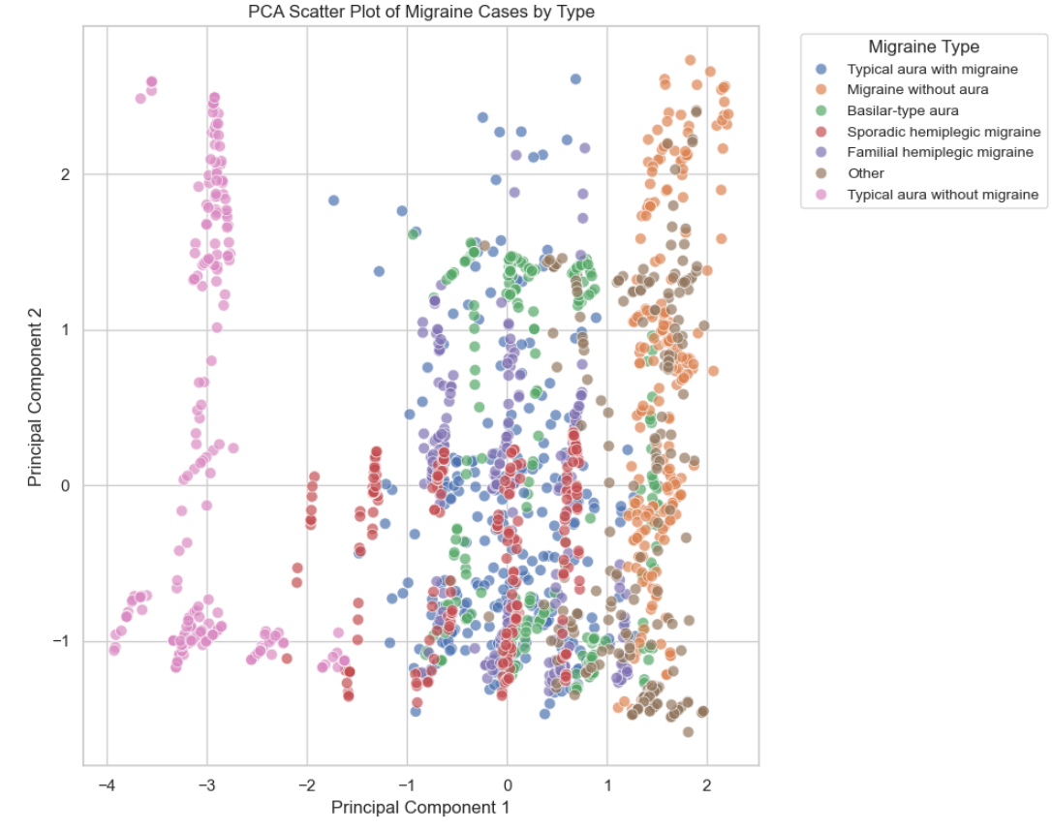
Principal component analysis
This scatterplot shows the sensitivity of each datapoint broken down by type.
Principal Components 1 and 2 are the 1st and 2nd most influential data cell in each patient row.
Positive scores show that the model's decision is highly sensitive to the component negative scores show less sensitivity. Lower scores show a well-rounded decision based on multiple values.

Slide 26
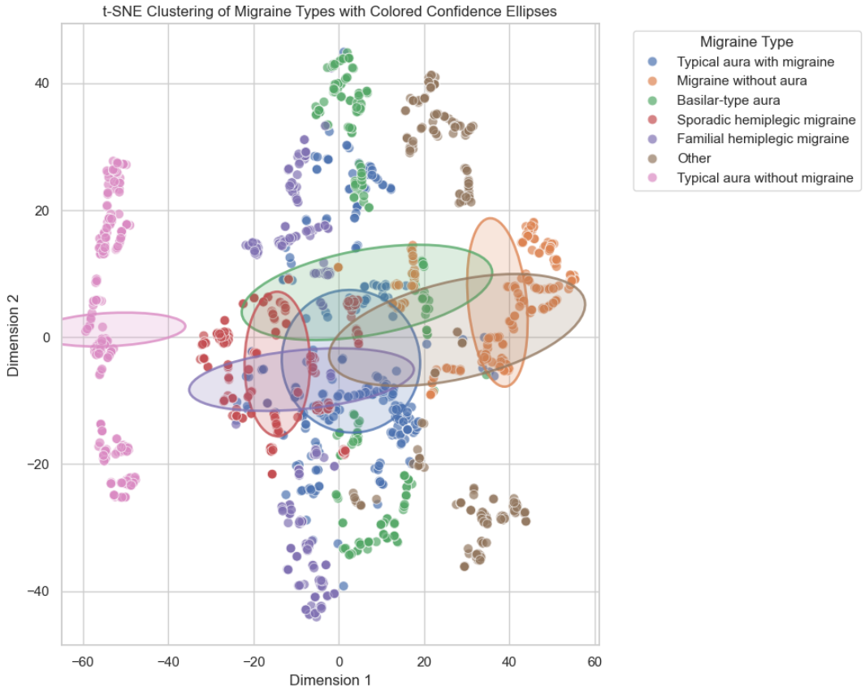
T-sne clustering by migraine type
This chart shows the different migraine types broken down by similar symptom records. How close each data point is to one another shows how close each of them have to identical symptoms, duration, intensity, location and frequency.
This is a 2D representation however the algorithm that creates this chart starts in a 60-dimensional space but can break it down to this 2D space after computation thanks to the label encoding and symptom binarization
Clusters show what the Model would confidently classify a hypothetical case as if it fell into that area
This Chart shows the Clustering before the importance scoring is factored In.

Slide 27
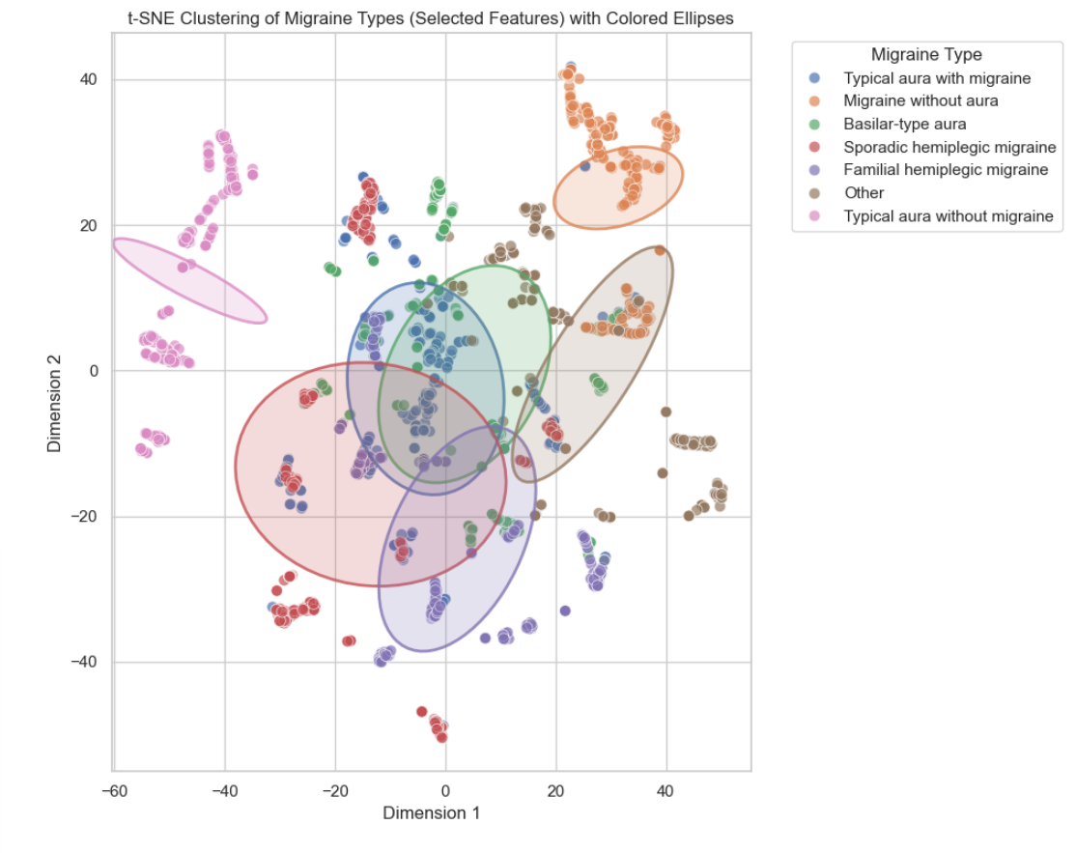
T-sne with feature importance scores
This chart shows the transformed t-SNE by accounting for the feature selection scores calculated earlier.
Thanks to those score weighing various columns, Some clusters have clearly become more distinct allowing the machine learning models to have an increased confidence
Less cluster overlap means a higher accuracy.

Slide 28
Building machine learning models

Slide 29
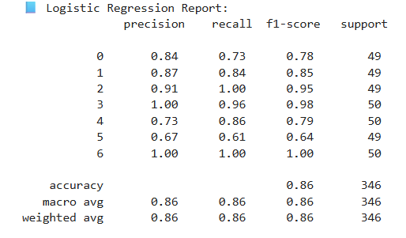
Logistic Regression
A linear regression model that predicts a probability that a given input belongs to a class of migraine using the logit function to create a probability and combines them linearly, while using a sigmoid to keep the output as a proportion between 0 and 1.
This model is 86% accurate

Slide 30
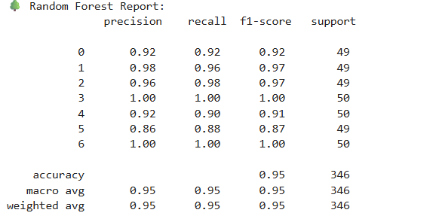
Random Forest
A machine learning algorithm that builds multiple decision tress and combines their outputs to make a final prediction.
This model is 95% accurate. But the model is not good a extrapolating outside the training data unlike the logistical regression

Slide 31
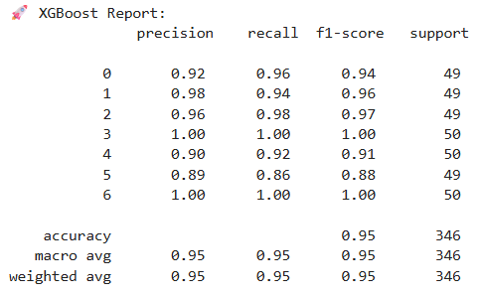
xgboost
An upgraded random forest model that will generate trees sequentially, correcting the errors of the previous trees. Also includes regularization to prevent skewing due to complexity. Uses first and second derivatives for optimization. However, if the dataset have a lot of outliers a traditional random forest will be better suited.
This model was 95% accurate.

Slide 32
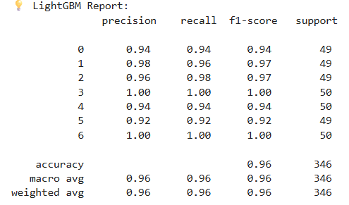
Lightgbm
A lightweight xgboost that grows trees in a more precise way that will reduce more error, leading to longer trees that are often more accurate. Uses less memory than typical xgboost.
This model is 96% accurate

Slide 33
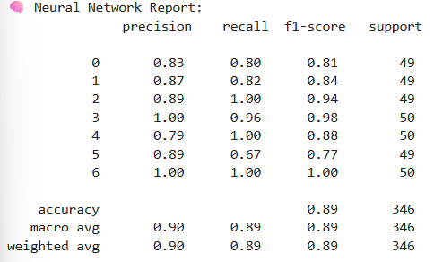
Deep learning neural network
A model inspired by how the human brain processes information. A system of nodes that act as neurons that receive input and transform it to more nodes forming an output.
This model is 90% accurate.

Slide 34
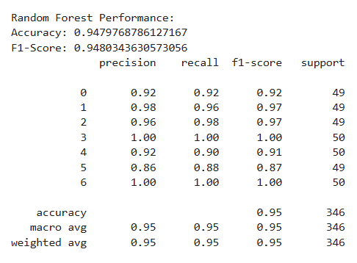
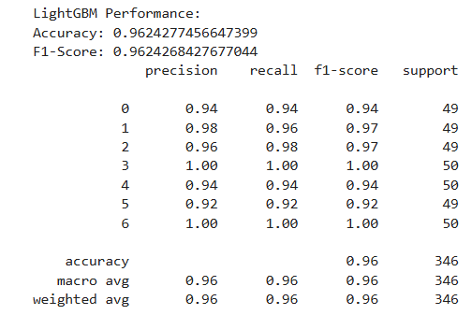
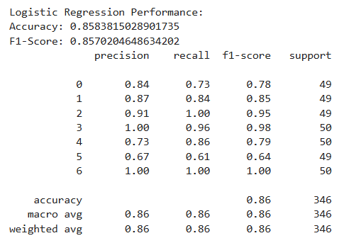
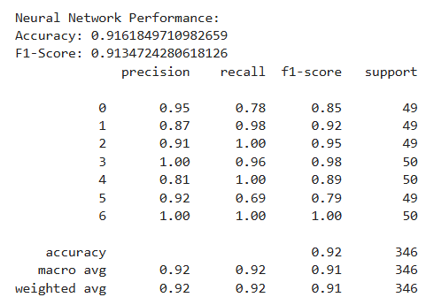
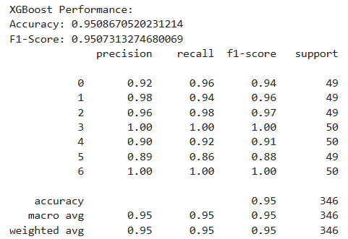
Model optimization
Using Optuna all models were fine tuned for slightly better accuracy and efficiency. Oputna was limited from running its full optimization study due to computation and time constrains, however all models did marginally improve. All Optuna values are shown to the size for comparison to original training values.
After optimization:
Random Forest performed the same
Logistic Regression performed the same
XGB performed the same
LightGBM increased in accuracy by 1%
Neural Network increased in accuracy by 2%
Further research can be done by unleashing Optuna on these models on a more sophisticated server with ample time.

Slide 35
Cross validation and grid searching
To ensure the models are not guessing and can preform well on unseen data that it hasn’t trained on further testing was warranted. Both these methods combined makes the models more robust and squeezes out extra performance forging well-tuned, high-performing, trustworthy models.

Slide 36
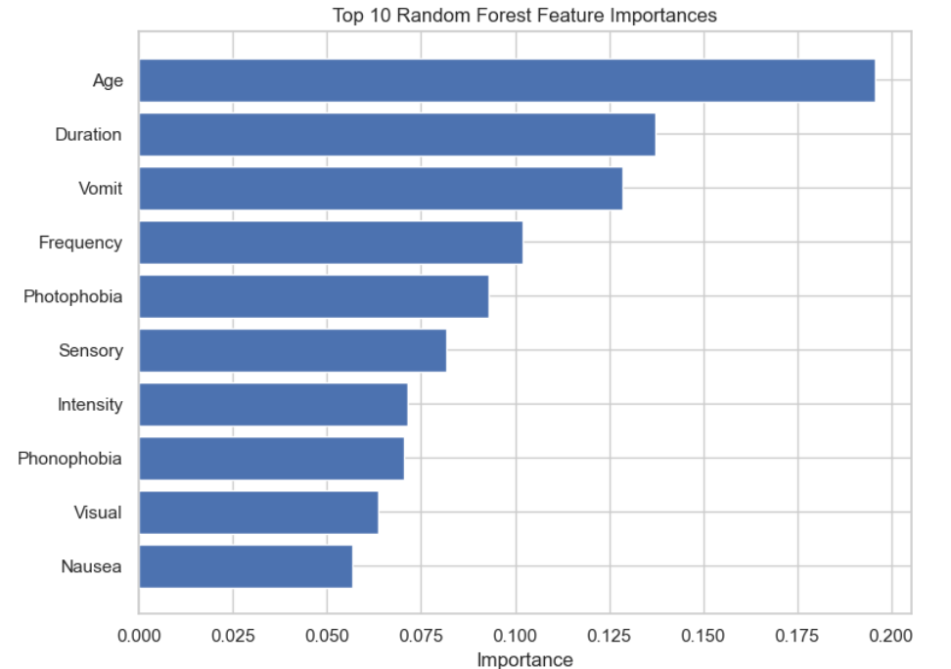
Model evaluation
By revisiting feature importance after all the models have completed training and testing one can see what data columns are seen as the most valuable by all the different models

Slide 37
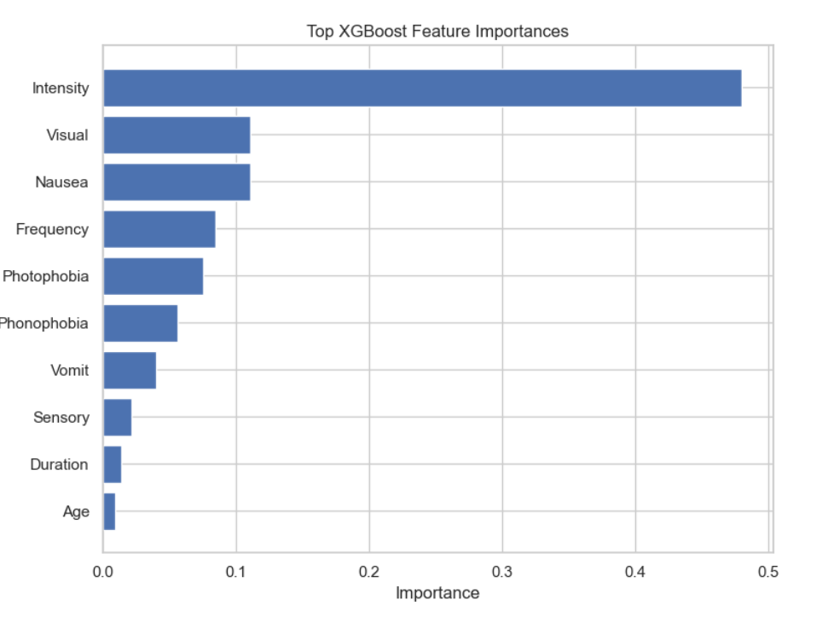
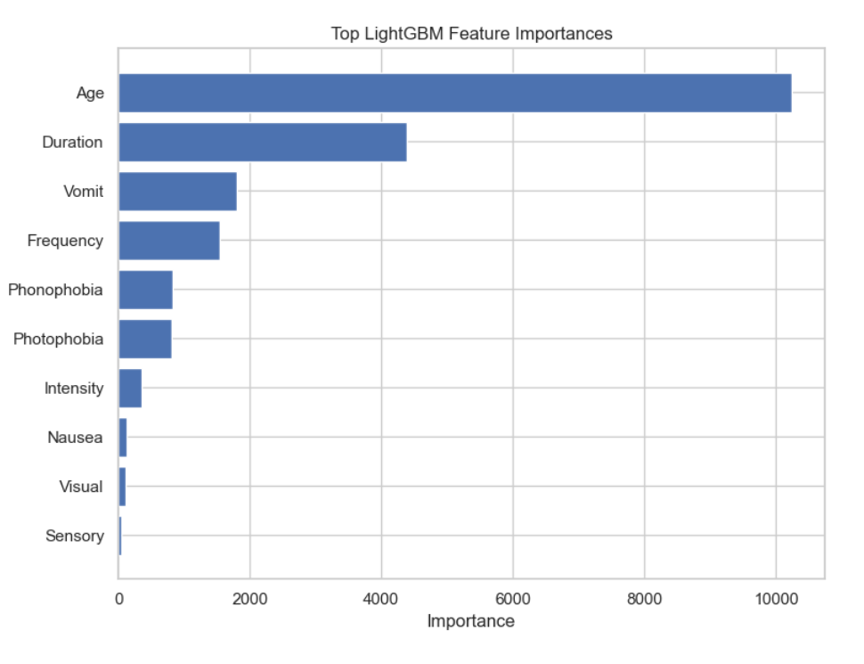
Model evaluation (cont.)

Slide 38
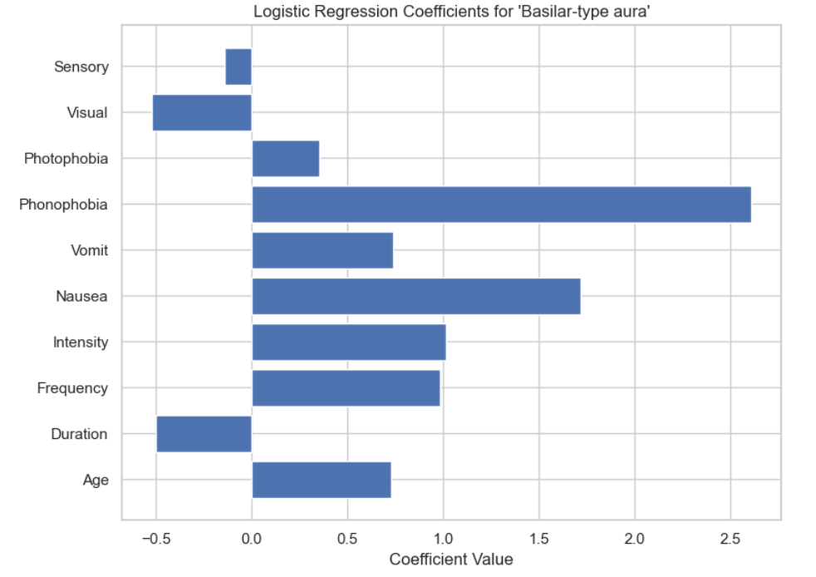
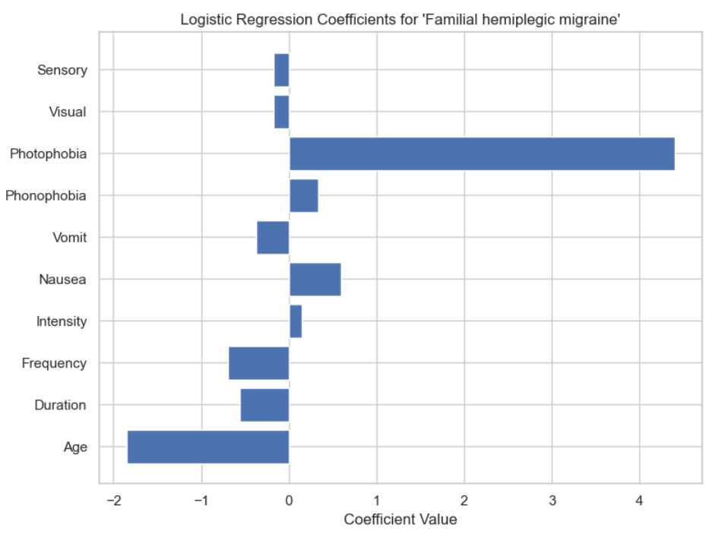
Model evaluation (cont.)

Slide 39
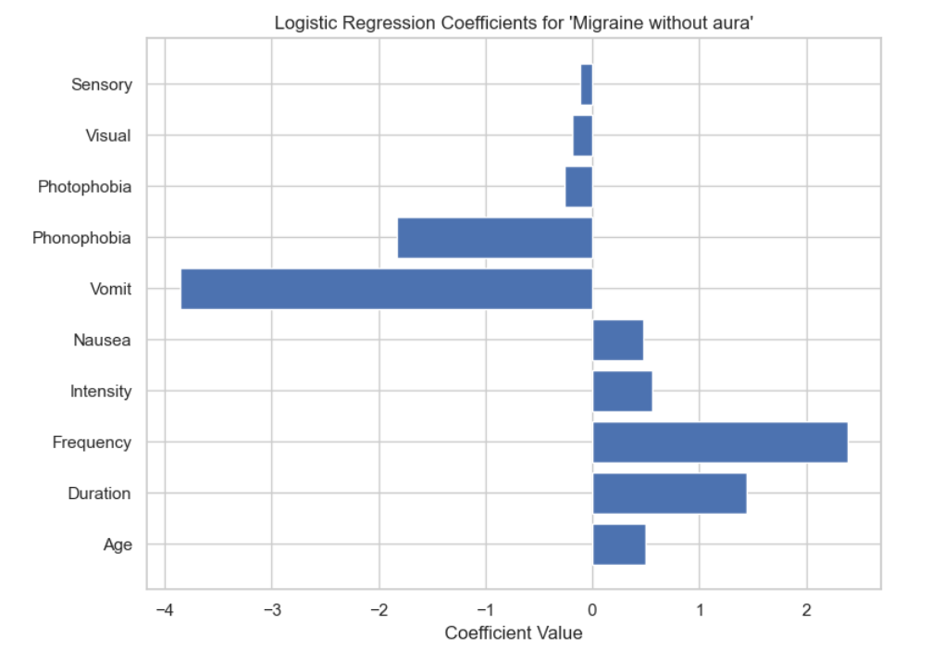
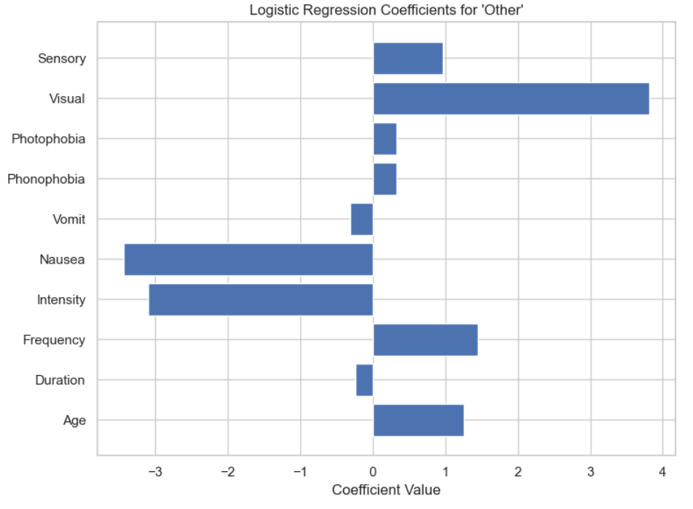
Model evaluation (cont.)

Slide 40
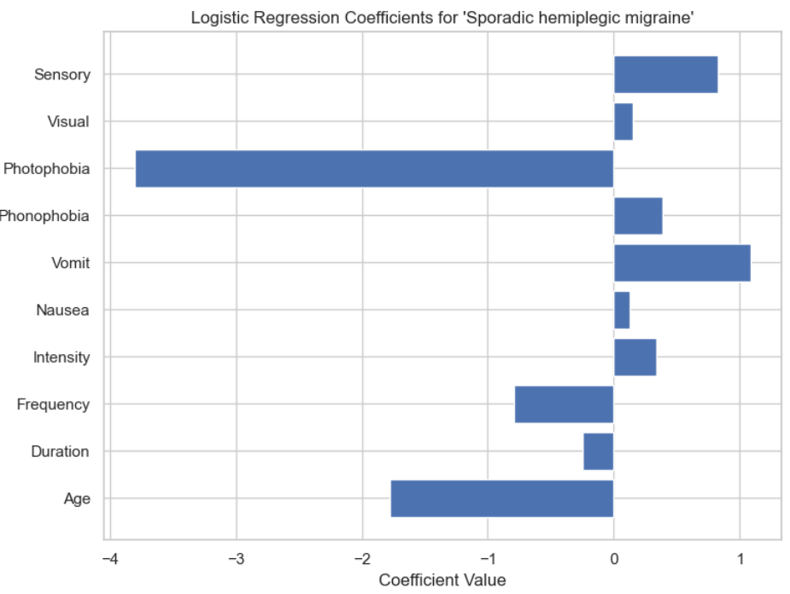
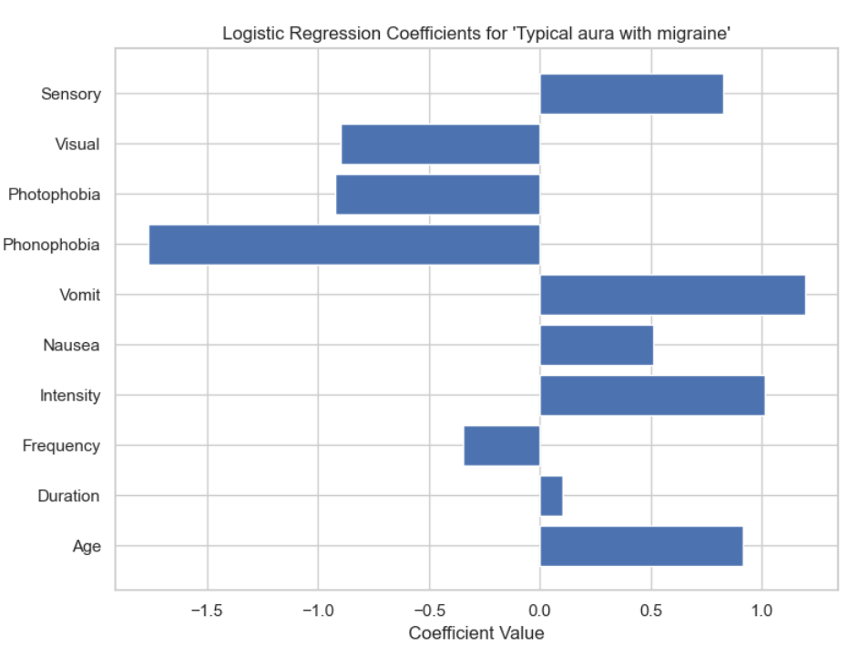
Model evaluation (cont.)

Slide 41
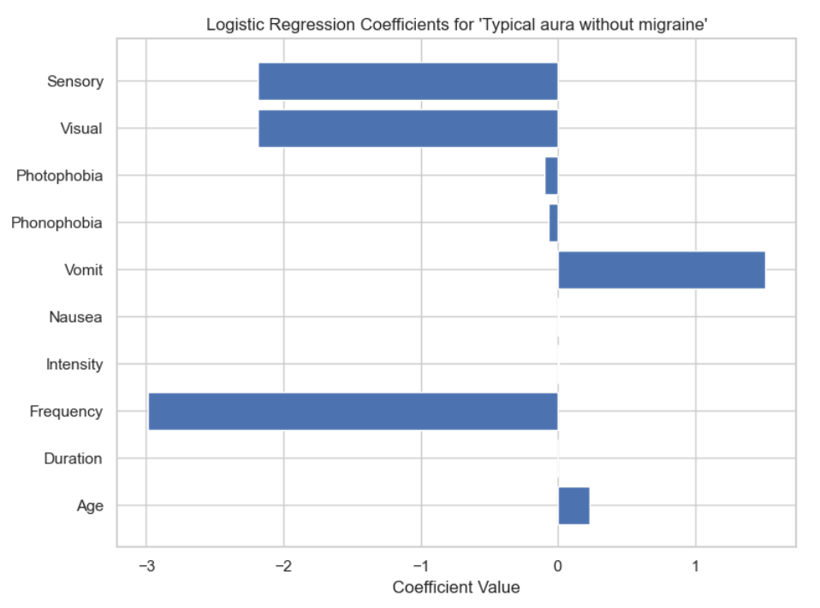
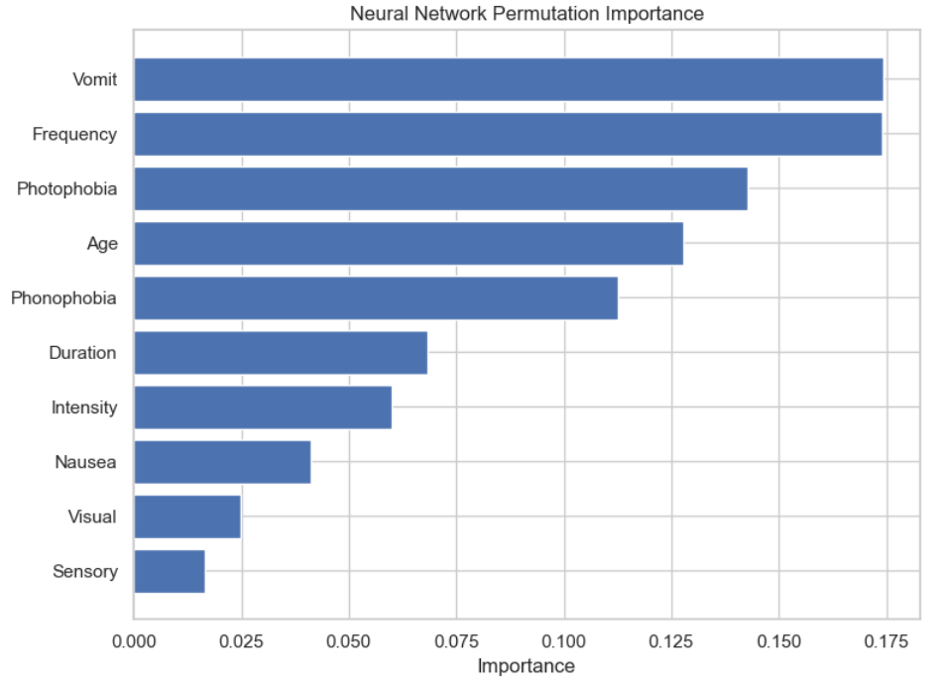
Model Evaluation (cont.)

Slide 42
Model Evaluation (final)
The last series of several charts provide ample data on what each model values when making decisions.
It is important to note that event though the logistical regression is the least accurate model it provide a plethora of statistical data that can be broken down by migraine type to show which features the model credits to confirming a certain diagnosis or discredits a diagnosis. This data is very useful as it shows more of the model's decision-making process than the rest of the models can allowing for future fine tuning.

Slide 43
Model saving and best model selection
All learning models are saved for future use as well as the label encoder and the multilabel binarizer to allow for quick and simple deployment
The best model was selected as the LightGBM model because it had the highest accuracy and a robust F1 score showing it preforms good consistently

Slide 44
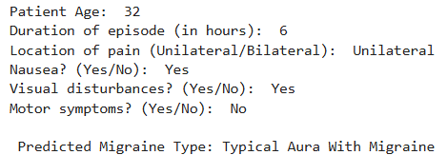
Model Deployment
A user input function was created to query the model with new information and get a result back

Slide 45
Future scope
Researchers should continue to collect data on:
migraine types underrepresented in this dataset
age groups underrepresented in this dataset
Further use of optuna and other tuning software can help increase model performance
More complex Neural Network algorithms can be used like RNN

Slide 46
Target Audience
This report is targeted towards:
Insurance companies
medical professionals
public health professionals
pharmaceutical companies
data scientists
people suffering from migraines

Slide 47
Thank you

